Slide 1
3D Print Scheduler: the analysis, the redesign and the code
SYSTEM DESIGN · EXAM ASSIGNMENT 2 · DEFENCE PREP
Your TD2 exactly as submitted (33 pages) and your refactored code, explained step by step, with a live-demo script and the questions you can expect.
Rokas Pazera · 551495 · prepared 5 November 2026
Notes:
Same approach as the EA1 deck: go through it once tonight, then drill slides 41 to 48 out loud. EA2 is the part where they ask you to open your code, so slides 32 to 38 (the code, the demo script and the tests) matter most. Tonight, also open the project in IntelliJ and run the 9 tests once, so nothing surprises you tomorrow.

Slide 2
EA2 is where they open your code
START HERE
Rubric rows that are only about EA2 (30 of 85)
From the workbook
Criterion | What “excellent” says
Code analysis · 15 | Clear and well-founded; smells clearly explained and demonstrably incorporated into the redesign
Refactoring · 15 | Convincingly demonstrated; code in line with the design; SOLID and patterns applied consistently
“You will also be asked to demonstrate parts of the refactored code (3DPrinterSchedule), so make sure you have the code available.” Have IntelliJ open with the project before you walk in.
The refactored code must
The C4, UML and design rows (55 points) cover both TDs. For EA2 the winning move is a chain: smell → problem → redesign → the exact lines of code.
(a) address the major issues, (b) be more extensible and maintainable, (c) apply SOLID and patterns correctly, (d) still behave the same as before. Point (d) is the one to prepare (slide 42).
Notes:
“Demonstrably incorporated” means: for every smell, you can point at the class or method that fixed it. Your smells table already has a “Solved by” column; this deck turns that into a demo you can walk through in the code (slide 37). For (d), have one calm sentence ready: same behaviour for every normal case, changed only where the old code crashed, lost a task, or did nothing.

Slide 3
Your refactoring in 60 seconds
START HERE · LEARN THIS BY HEART
The scheduler tells Jack which print to start on which printer, with as few spool changes as possible.
The old code had two god classes: Main (385 lines: menu, input and file reading) and PrinterManager (304 lines: everything else), with a 110-line selectPrintTask that decided per printer type with instanceof. The strategy menu only changed a String. I split the code by job into five components. Printers now know what they can print through one template method, canPrint(), and a PrinterFactory is the only place with the type numbers. A real Strategy decides one thing: which free spool to use. selectPrintTask went from 110 to 23 lines, which exposed two hidden bugs, and nine unit tests now check the behaviour without Main or the JSON files.
Notes:
Use this when they say “Tell us about EA2.” It names the two god classes, the long method, the fake strategy, the three patterns (Template Method, Simple Factory, Strategy) and the tests, so every follow-up question lands on something you prepared.

Slide 4
Four problems, four fixes
START HERE · THE MENTAL MODEL
1
Two god classes, no separation. Main mixes menu and file reading; PrinterManager does the rest.
Split by job: Console UI (Main), DataLoader, PrinterManager, Print Strategies, Domain Model.
2
Printer types not used as types. instanceof branches decide what a printer can print; a new type = 6 places.
Printer.canPrint() as a template method; each subclass answers its part; PrinterFactory holds the type numbers.
3
A fake strategy. The menu only changed a String; nothing behaved differently.
Strategy pattern: PrintStrategy.chooseSpool() with two working strategies.
4
State in three places, one huge method. spools, freeSpools and spool fields kept in sync by hand.
One List<Spool> per printer; selectPrintTask split into short methods, which exposed two bugs.
Notes:
These are the three main problems from your presentation (slide 9 of your deck), with the spool state split out as a fourth. Any question about EA2 maps onto one of these rows. If you blank, start with: “The core problem was that printer types were not used as types.”

Slide 5
Where everything is in your PDF
START HERE · NAVIGATION
§ | What | Page
2.1 | Context diagram | 4
2.2 | Use case diagram | 5
3.1 | Container diagram, table | 6
3.2 | Deployment diagram | 7
4.1 | Old code: overview, lines | 7-8
4.2 | Old code: 3 class diagrams | 9-12
4.3 | How the old code works | 12-13
5 | Code smells table | 14-15
6.1 | Structural problems | 17
6.2 | Bugs, behaviour changed | 17-18
§ | What | Page
7.1 | Layer 3 components, mapping | 19-22
7.2 | Domain model (printers, data) | 23-25
7.3 | Manager, strategies, loader, UI | 26-28
7.4 | SOLID and patterns | 28-29
8 | Refactoring per file | 30
9 | Testing (9 tests) | 31
10.1 | Decisions 1 to 5 | 32-33
10.2 | Insights | 33
code | 3dprintscheduler-main/src | slide 37
Notes:
Page numbers are what the PDF viewer shows (title page = 1). The table of contents inside your TD2 shows “9” for almost every section, so do not navigate by it. The two places they will most likely ask you to open: the smells table (section 5) and the decisions (section 10.1).

Slide 6
Each requirement, and where it lives now
THE CASE · JACK’S REQUIREMENTS
Requirement | In the refactored code
F1 · menu with number input (U6) | Main.menu(), menuChoice(), numberInput()
F2 · printers with spools and jobs | Main.showPrinters(); Printer.toString() with the details() hook
F3, F4 · list prints; spools with length | Main.showPrints(), showSpools()
F5 · add a task: print, filament, colors | choosePrint, chooseFilamentType, chooseColors → manager.addPrintTask()
F6 · start the queue, fill every printer | PrinterManager.startInitialQueue() → selectPrintTask per printer
F7 · completion: reduce spool, pick next | registerCompletion() → finishPrintTask() + selectPrintTask()
F8 · failure: back to queue, reduce, pick next | registerPrinterFailure(): re-queue, finishPrintTask(), selectPrintTask()
F9 · choose a strategy (U10, B6 leftovers) | PrintStrategy + two strategies; Main.changePrintStrategy()
NF1-NF4 · one computer, no printer link, local files, text UI | One Java 21 console app reading JSON files; Jack handles the printers by hand
Notes:
Two case facts that explain design choices. First, the printers are not connected to any computer (NF2), so there is no relation between the scheduler and the printers in your C4 diagrams. Second, “in the future Jack would like an alternative method of scheduling where small remaining spools can be used up efficiently” (B6): that is exactly your Efficient Spool Usage strategy. U1 and U2 (add printer, add print) are done by editing the JSON files, as in the original; the case says adding printers “doesn’t happen a lot”.

Slide 7
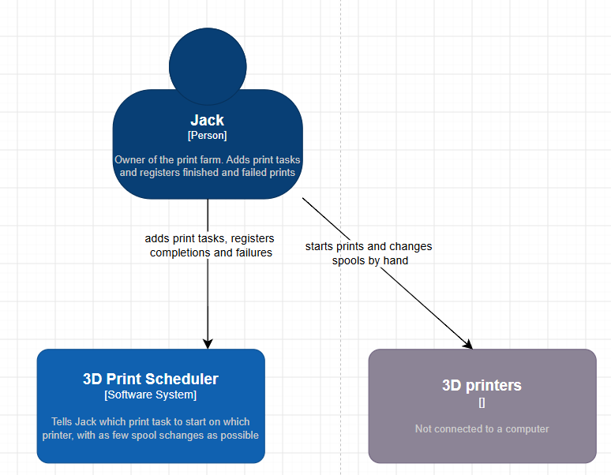
Jack is the link to the printers
C4 LAYER 1 · CONTEXT · §2.1
One person: Jack, owner of the print farm. He adds tasks and registers finished and failed prints.
One system: the 3D Print Scheduler. It tells Jack which task to start on which printer, with as few spool changes as possible.
The printers are external, with no arrow to the scheduler. They are not connected to any computer (NF2). The scheduler tells Jack; Jack does it by hand.
Notation check: the printers’ type label is empty (“[]”) and there is no legend.
Notes:
Say: “The only user is Jack. The 3D printers are an external system, but there is no relationship between them and the scheduler, because they are not connected to any computer. Jack is the link between the two: the scheduler tells him what to do and he does it by hand.” If they point at the empty label: “It should say what the element is, for example [Hardware, not connected]. And a legend should be there, as in my EA1 diagrams.”

Slide 8
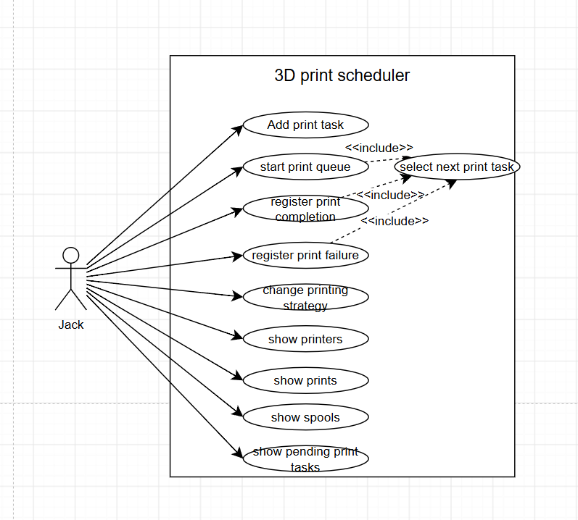
What Jack does with the scheduler
C4 LAYER 1 · UML USE CASE · §2.2
Nine use cases, one per menu option: add task, start queue, register completion, register failure, change strategy, and four “show” lists.
«include» select next print task from start queue, completion and failure: in all three the program picks a task for a free printer. Dashed arrow from the base to the included case: correct.
No “add printer” or “add print”: those are done in the JSON files (U1, U2), as in the original.
Notation check: the actor-to-use-case lines have arrowheads; in UML they are plain lines.
Notes:
This diagram is better than your EA1 use case diagrams: ovals, a system boundary and a correct dashed «include». The «include» is the key point: “select next print task” is the heart of the program and three use cases share it, which is exactly why selectPrintTask is called from three places in the code (startInitialQueue, registerCompletion, registerPrinterFailure).

Slide 9
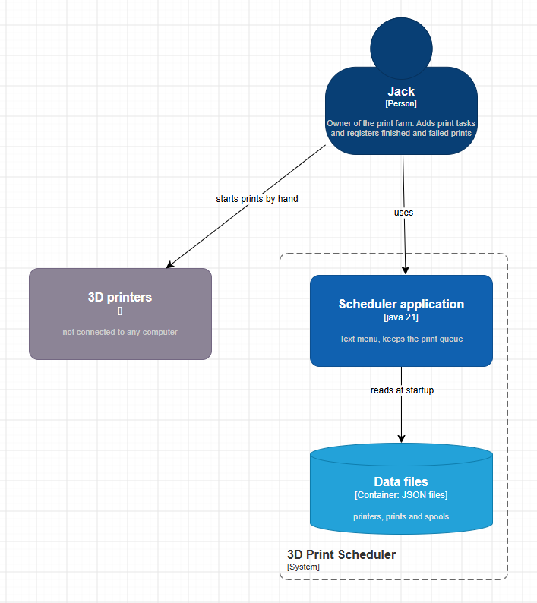
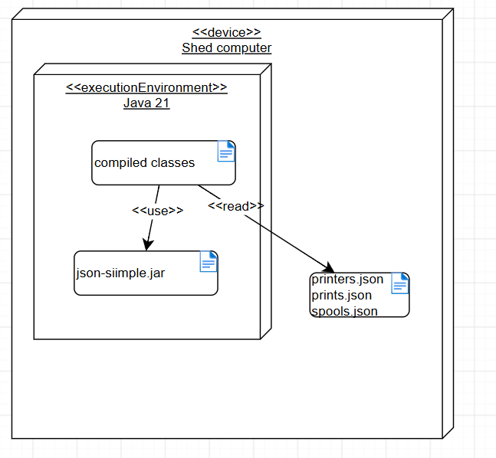
One app and its data files, in the shed
C4 LAYER 2 · CONTAINER AND DEPLOYMENT · §3
Scheduler application (Java 21 console app): menu, queue, running tasks and spool lengths in memory; picks the next task.
Data files (JSON): printers, prints, spools; read at startup.
Deployment: one «device» Shed computer; Java 21 runs the classes, which use json-simple.jar and read the JSON (NF1, NF3).
Check: label “[java 21]” should be “[Container: Java 21 console app]”; “json-siimple” typo.
Notes:
Why so small? Jack is the only user, on one small computer in his shed, and the case explicitly asks for a single-computer program with a text interface and local files (NF1 to NF4). The workbook lets you add containers when they are justified; nothing here needed one, and adding a database or server would be speculative generality, the same smell you removed from the code. If asked “where are the JSON files at runtime?”: DataLoader reads them from the classpath with getResourceAsStream, from the resources folder, just like the original read them via getResource.

Slide 10
The old code: two classes do everything
CODE ANALYSIS · §4.1
Class | Lines | What it does
Main | 385 | Menu, keyboard input, all screens, reading the 3 JSON files, and the “strategy” (only a String)
PrinterManager | 304 | Printers, prints, spools, free spools, free printers, queue, running tasks; selects tasks, checks input, prints messages
Printer, StandardFDM, HousedPrinter, MultiColor | 40, 63, 8, 59 | Printer data, the size check and the loaded spools
Print, PrintTask, Spool, FilamentType | 53, 35, 65, 5 | Data classes
At layer 3 the old program has only two real components: Main (UI and file loading) and PrinterManager (everything else). Two packages: nl.saxion and nl.saxion.Models.
689 / 1017
lines live in just Main and PrinterManager: two thirds of the program.
Notes:
The 689 of 1017 figure is computed from your own line counts (385 + 304, of 1017 lines in the ten source files); it is not written in the PDF, so say it as “about two thirds”. Opening line for the analysis: “The code has two packages. At layer 3 it has only two real components: Main does the user interface and file loading, and PrinterManager does everything else.”

Slide 11
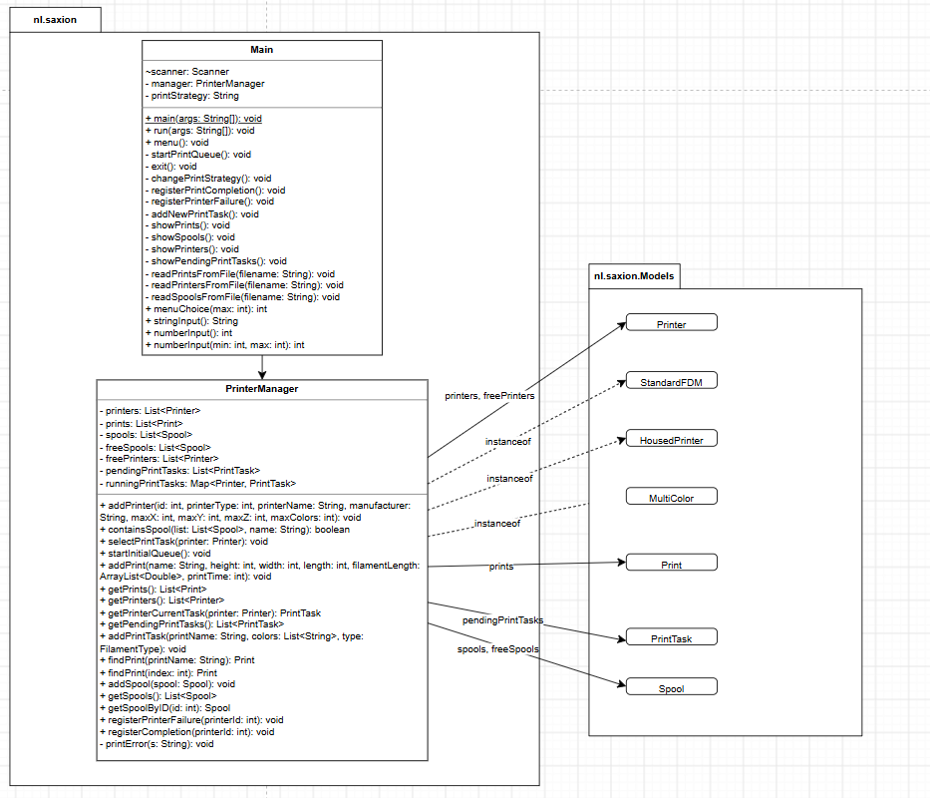
Old nl.saxion: Main and PrinterManager
CODE ANALYSIS · OLD CLASS DIAGRAM · §4.2
Main keeps the strategy as a String (printStrategy) and has three read…FromFile methods next to every screen.
PrinterManager keeps seven collections: printers, prints, spools, freeSpools, freePrinters, pendingPrintTasks, runningPrintTasks.
addPrinter takes 8 parameters, addPrint 6 (Long Parameter List).
The dashed «instanceof» arrows show the hidden coupling: the manager depends on every concrete printer class.
The workbook asks for insight, not a generated diagram. Those instanceof arrows are your insight.
Notes:
A generated class diagram would not show the instanceof checks, because they are not fields or method signatures. You drew them as dependencies on purpose, to show why a new printer type means editing PrinterManager. Say that if they ask “how is this different from a generated diagram?”.

Slide 12
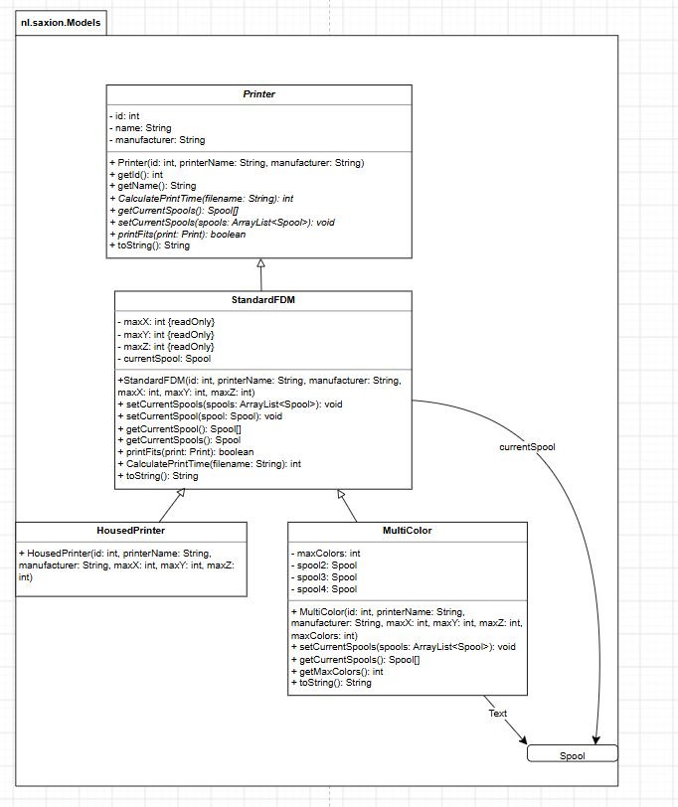
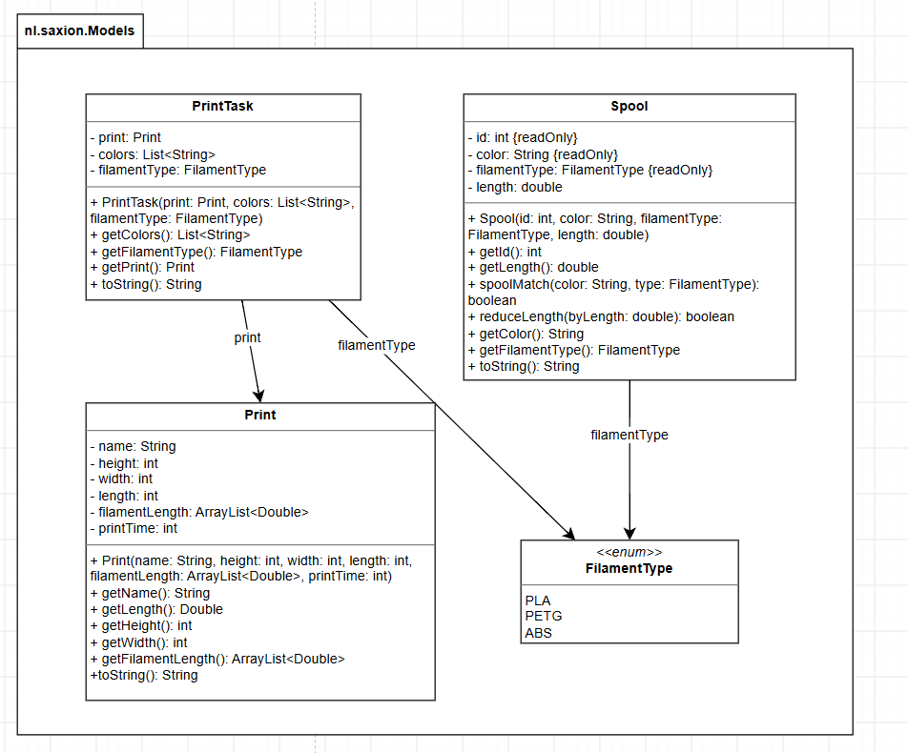
Old nl.saxion.Models
CODE ANALYSIS · OLD CLASS DIAGRAMS · §4.2
CalculatePrintTime: abstract, returns 0, never called.
MultiColor adds spool2-4 and replaces StandardFDM’s spool handling.
HousedPrinter is empty: its ABS rule lives in PrinterManager.
Print.getLength() returns Double for an int field.
Notes:
Smell names for each point: CalculatePrintTime is Speculative Generality (and wrong naming: methods start lower-case in Java). MultiColor is Refused Bequest plus Data Clumps (spool2, spool3, spool4 and new Spool[4]). HousedPrinter is a Lazy Class. The printer classes are mostly data holders, because the decisions about them sit in PrinterManager: that is the root problem you fixed with canPrint().

Slide 13
The old selectPrintTask
CODE ANALYSIS · HOW THE OLD CODE WORKS · §4.3
Pass 1, keep the spool: take the first queued task that fits and matches the loaded spools.
// pass 1, simplified
if (p instanceof StandardFDM
Pass 2, change the spool: the first task that fits with a matching spool in freeSpools; the old spool goes back; Jack gets a “spool change” message.
&& type != ABS && colors == 1)
start task (copy 1)
else if (p instanceof HousedPrinter
Three instanceof branches in each pass. Order matters: HousedPrinter and MultiColor are also StandardFDM, so a one-color PLA task on a MultiColor runs through the StandardFDM branch.
&& colors == 1)
start task (copy 2)
else if (p instanceof MultiColor
The printer rules live here (“standard can’t print ABS”, “up to maxColors”), not in the printer classes.
&& type != ABS && colors <= max)
start task (copy 3)
// pass 2: the same three again
Spool state in three places: spools, freeSpools, and currentSpool/spool2/spool3/spool4.
// = 6 copies of the start block
110 lines · 6 levels of nesting · no busy check in pass 1
Notes:
This is the slide to explain the core of the old program. Say: “selectPrintTask works in two passes: first it tries to keep the spool, then it changes the spool. Inside each pass there are three branches chosen with instanceof, one per printer type. So the rules of every printer type are in this one method, not in the printer classes.” Fun fact you can use: the original method runs from line 37 to 149 of PrinterManager.java.

Slide 14
Bloaters, duplication and type checks
CODE ANALYSIS · SMELLS (1 OF 3) · §5
Smell: where | Why it hurts | Solved by
Large Class: Main | A file-format change and a menu change touch the same class | DataLoader reads the files; Main is only the console UI
Large Class, Divergent Change: PrinterManager | Storage, queue, scheduling, validation, output in one class | Rules to the printers, spool choice to strategies, reading to DataLoader
Long Method: selectPrintTask (110 lines, 6 levels) | Hard to read, impossible to test in parts | Split: selectPrintTask, chooseFreeSpools, changeSpools, startPrintTask
Duplicate Code: start block 6×, two equal branches, completion vs failure, 3 read methods | A fix in one copy is forgotten in the others | startPrintTask, finishPrintTask, readJsonArray, FilamentType.values()
Switch Statements: instanceof; type number if/else | A new printer type = changes in 6 places | Printer.canPrint(); PrinterFactory
Notes:
For each row, practise the full chain: smell name, where, why it hurts, and the class or method that fixed it. That chain is what “demonstrably incorporated into the redesign” means in the rubric. Smell names follow refactoring.guru, the same source you used in the week 5 and 6 exercises.

Slide 15
Weak types, dead weight
CODE ANALYSIS · SMELLS (2 OF 3) · §5
Smell: where | Why it hurts | Solved by
Refused Bequest, Lazy Class: MultiColor, HousedPrinter | Hard to say what a printer can do | Spools as one list in Printer; subclasses override only what differs
Data Clumps, Primitive Obsession: spool2-4, type as int, strategy as String | Max 4 colors hard-coded; a String can’t do anything | List<Spool>, PrinterFactory, PrintStrategy objects
Long Parameter List: addPrinter (8), addPrint (6) | Easy to swap two ints by mistake | The manager gets ready objects from DataLoader and PrinterFactory
Dead Code: freePrinters, getSpoolByID, containsSpool, exit(), imports | Noise, and freePrinters still had to be kept in sync | Removed
Speculative Generality: CalculatePrintTime | Every new printer class must implement it for nothing | Removed
Notes:
Primitive Obsession is the cleanest example of “demonstrably incorporated”: the strategy was a String in Main, now it is a PrintStrategy object the manager actually calls. The type number was an int that PrinterManager interpreted with if/else, now only PrinterFactory knows it. The four spool fields became one List<Spool>, so the maximum of 4 colors is no longer built into the class.

Slide 16
Misplaced logic, and one smell you kept
CODE ANALYSIS · SMELLS (3 OF 3) · §5
Smell: where | Why it hurts | Solved by
Feature Envy: PrinterManager decides what a printer can print; showPrinters edits toString() text | Logic far from the data it uses | Printer.canPrint(); the current task on its own line
Fragile inheritance: subclasses replace and split the superclass’s toString() text | Lines shown twice; a superclass change breaks subclasses | Template Method: toString() calls the details() hook
Comments (fake feature): “this method only changes the name but doesn’t actually work” | Jack thinks he changed the strategy | Strategy pattern with two working strategies
Divergent Change: PrinterManager writes to System.out | Another kind of UI would mean changing PrinterManager | KEPT on purpose: same console text; tests check state, not text
Notes:
The kept smell is a strength if you explain it: you saw it, named it, and chose not to fix it for a reason. Reason: requirement (d) asks for the same behaviour, and the console messages are that behaviour for Jack; the tests check the state (which printer runs which task, which spool is loaded), so the printing does not get in the way of testing. Next step if they ask: PrinterManager returns results or notifies a listener, and the console UI prints them.

Slide 17
Five structural problems behind the smells
CODE ANALYSIS · §6.1
No separation of UI, logic and data. File reading sits in Main; every printer rule is hidden in one 110-line method.
→ five components, one job each
Printer types aren’t used as types. The classes are data holders; each new type changes the scheduling code.
→ canPrint() with per-type answers, PrinterFactory
No extension point for scheduling. The strategy menu exists but changes nothing.
→ PrintStrategy interface
State kept in several places by hand. spools/freeSpools, printers/freePrinters and the spool fields must stay in sync.
→ one List<Spool> per printer; freePrinters removed
Loading a file takes too many steps. getResource → path → URLDecoder → FileReader, repeated in three methods.
→ one readJsonArray() with getResourceAsStream
Notes:
Smells are symptoms; these five are the causes. If they ask “what is the difference between a smell and a structural problem?”: a smell is a local sign in the code (a long method, a type check), a structural problem is how the program is organised (no layering, no extension point). Several smells come from one structural problem: Switch Statements, Feature Envy, Refused Bequest and Lazy Class all come from “printer types aren’t used as types”.

Slide 18
Four bugs that crash or lose work
CODE ANALYSIS · BUGS (1 OF 2) · §6.2
Bug | What happened in the old code | Fix
Null spool | A printer without a spool gets its first one: freeSpools.add(getCurrentSpools()[0]) adds null. The next printer hits a NullPointerException; starting the queue with tasks for 2 printers crashes. | changeSpools only moves real spools (the list is empty at first)
Too few spools | Pass 1 for a MultiColor reads spools[i] without a null check: fewer loaded spools than colors crashes. | hasSpoolsFor first compares the counts
Busy printer | Pass 1 has no busy check: starting the queue twice replaces a running task, and that task is lost. | selectPrintTask returns at once when the printer is running
Spool in 2 printers | MultiColor keeps old spool2-4 when the new task has fewer colors, while they also went back to freeSpools. | All old spools go back first; the printer holds only the new list
Notes:
The busy-printer and too-few-spools bugs are the ones you found because you split the method: after the 110 lines became four short methods, the missing null check and the missing busy check were visible. That is your third insight (“small methods make bugs visible”). If asked “how do you know these are real?”: the null spool one shows up as soon as the queue starts with tasks for two printers.

Slide 19
Four smaller bugs, one deliberate change
CODE ANALYSIS · BUGS (2 OF 2) · §6.2
Bug in the old code | Fix
Spool.reduceLength subtracts twice when the spool goes below 0 | Subtract once
The strategy menu only changes a text (shown as “--Less Spool Changes”) | Real strategies
The printer overview shows maxX/Y/Z and the current task twice (String.replace hits both lines) | details() hook; task on its own line
Completion accepts printer IDs from -1, failure from 1 | Both from 1
Behaviour changed on purpose: which spool is picked
When several free spools match, the old code took the last one for one color (a loop without a break) and the first for more colors. Now the strategy decides; Less Spool Changes takes the longest. With the current spools.json that changes the spool for some prints, e.g. spools 11 and 12 instead of 1 and 2 for the Tree Frog.
Notes:
You wrote this down yourself in 6.2, which is good: a refactoring that changes behaviour must say so. Your reason for keeping bug fixes despite requirement (d): “keeping them would mean keeping crashes”. Your reason for the spool choice: the old choice was accidental (a loop without a break), not a rule anyone designed, and the longest spool lasts longest before the next change, which is what “less spool changes” means. Other one-color prints affected: Red, Green and Pink PETG and Red ABS.

Slide 20
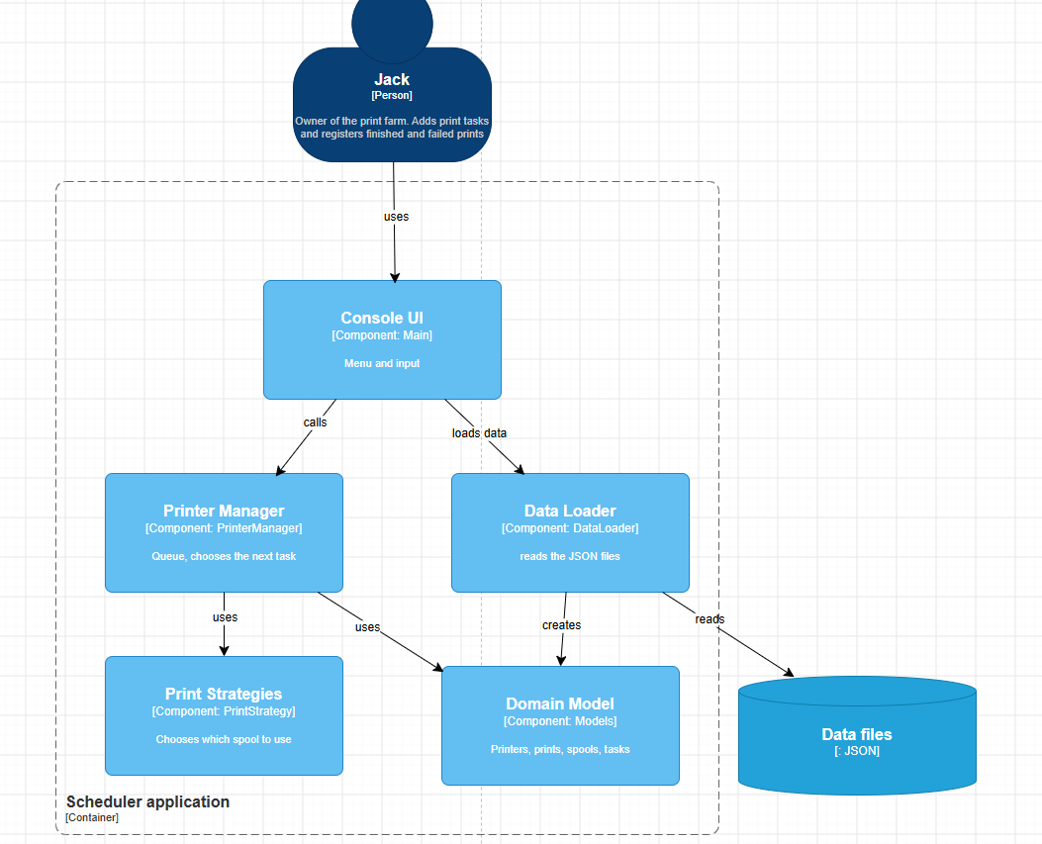
From two components to five
REDESIGN · C4 LAYER 3 · §7.1
Console UI = Main: menu and input.
Data Loader = DataLoader: reads the JSON files.
Printer Manager = PrinterManager: the queue; chooses the next task.
Print Strategies = PrintStrategy and two classes (nl.saxion.strategies): which spool.
Domain Model = printers, PrinterFactory, Print, PrintTask, Spool, FilamentType (nl.saxion.Models).
Before: 2 real components. After: 5, each with one reason to change.
Label check: Data files shows “[: JSON]”.
Notes:
The workbook says layer 4 is the focus and redesigning layer 3 is optional; you did both, and the table in 7.1 maps every layer-3 component to its classes and package, which ties the two layers together (consistency, the C4 rubric row). Say: “Now every component has one job: the console UI, the data loader, the printer manager, the strategies and the domain model.”

Slide 21
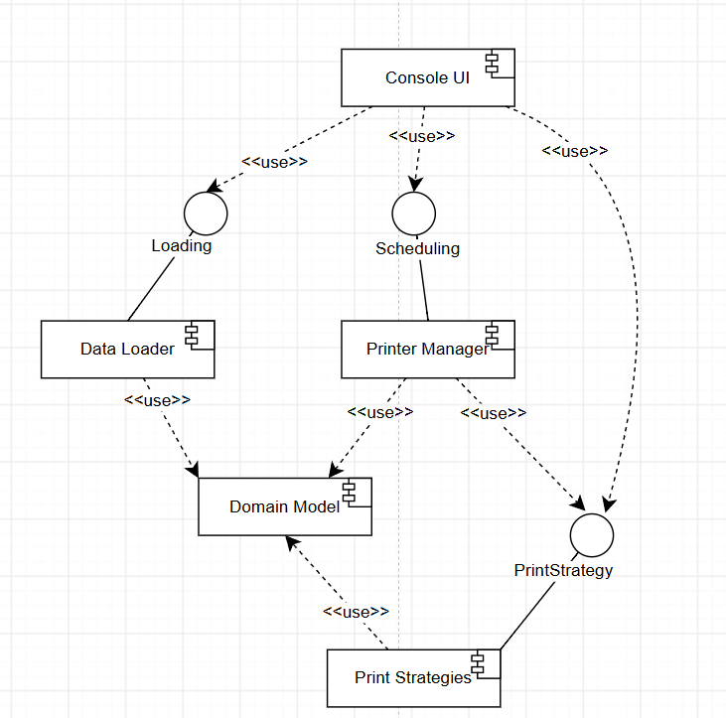
The interfaces between the components
REDESIGN · UML COMPONENT · §7.1
Loading = DataLoader’s public methods. Scheduling = PrinterManager’s public methods. PrintStrategy = a real Java interface.
Console UI uses all three: it loads the data, drives the manager, and creates the strategy the manager gets. Main is the composition root: it wires everything.
Dependencies point one way. PrinterManager knows neither DataLoader nor Main, so it can be tested alone.
Everything uses the Domain Model; the Domain Model uses nothing above it.
Notes:
From your text: “The C4 diagram shows the responsibilities, the UML diagram shows the interfaces between the components.” Why does the Console UI depend on PrintStrategy? Because the strategy menu creates the strategy object and gives it to the PrinterManager. That is Dependency Inversion in practice: the manager depends on the interface, and the outermost part of the program chooses the implementation.

Slide 22
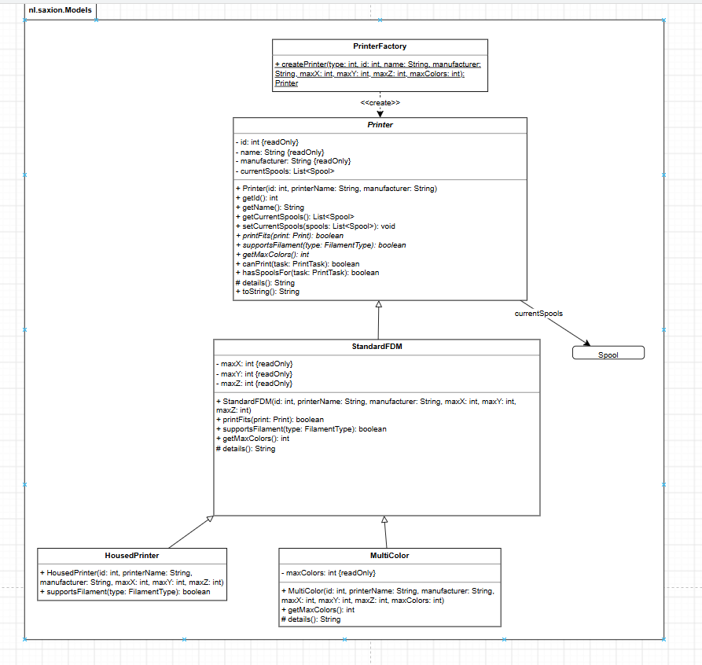
Printers now know what they can print
REDESIGN · LAYER 4 DOMAIN MODEL · §7.2
canPrint(task) is written once in Printer: printFits(print) and supportsFilament(type) and colors ≤ getMaxColors(). Template Method.
Each subclass answers its part. StandardFDM: size check, no ABS, 1 color. HousedPrinter: every filament. MultiColor: up to maxColors.
Spools: one ordered List<Spool>; the position in the list is the position in the printer.
hasSpoolsFor(task): do the loaded spools already match? That is pass 1.
details() is a protected hook (#) for toString().
PrinterFactory is the only place with the type numbers 1, 2, 3.
Notes:
Say: “The printers now know what they can print. canPrint is written once in Printer as a template method. Each subclass only answers: does the print fit, is the filament supported, and how many colours. PrinterFactory is the only place with the type numbers.” Notation: italic method names in Printer are abstract; # is protected; the underlined method in PrinterFactory is static. An unknown type number throws an IllegalArgumentException.

Slide 23
Why you kept the printer subclasses
REDESIGN · DECISION 2 · §10.1
Class (type number) | Filament | Colors | In printers.json
StandardFDM (1) | PLA, PETG | 1 | Enterprise, Serenity, Red Dwarf, Tardis
HousedPrinter (2) | PLA, PETG, ABS | 1 | Rocinante, Bebop
MultiColor (3) | PLA, PETG | up to maxColors | Heart of Gold (4 colors)
Considered: one Printer class with flags
Chosen: keep the subclasses
The honest cost
Fields housed and maxColors, no subclasses. A housed multi-color printer would need no new class.
printers.json already uses type numbers, the classes existed, and a future rule fits better in a subclass.
A housed multi-color printer = one new subclass plus one factory line.
Notes:
Expect a challenge here, because the case itself says “a printer can easily be placed in housing” and “printers can also be upgraded to carry more colors”. That is the best argument for the flags design. Your answer: “True, and I considered it. I kept the subclasses because the data already uses type numbers and the rules really differ per type; if Jack builds a housed multi-color printer, that is one small subclass and one line in the factory, and PrinterManager does not change.” All printers also check the size: the print must fit within maxX, maxY and maxZ.

Slide 24
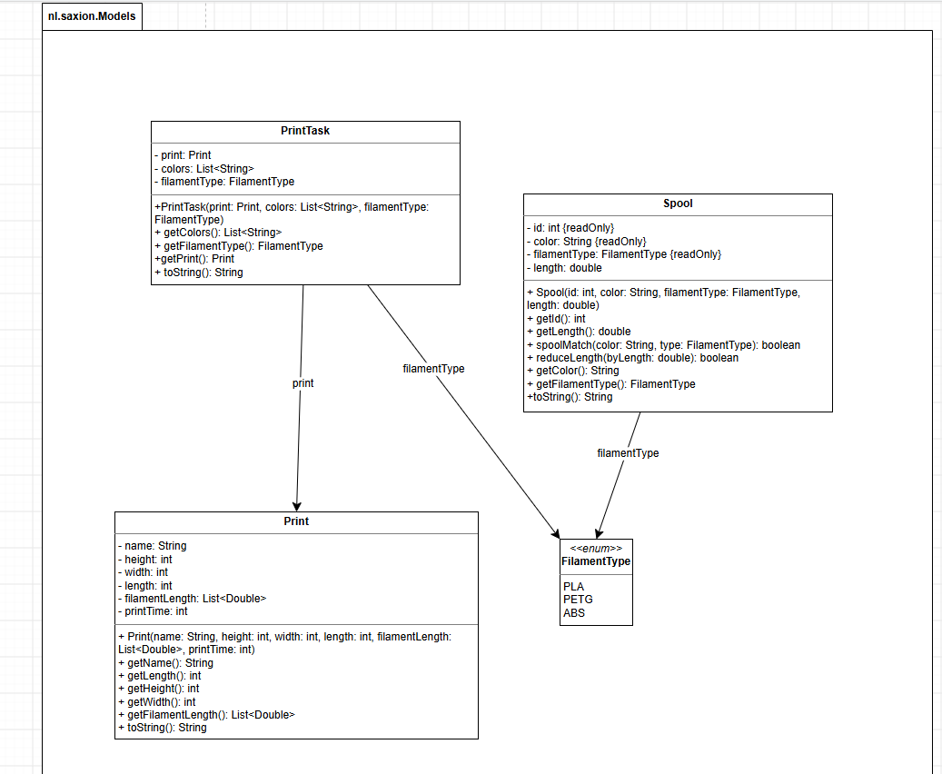
The data classes: small, careful changes
REDESIGN · LAYER 4 DATA CLASSES · §7.2
Print: List<Double> instead of ArrayList (program to the interface); getLength() returns int, like the field.
Spool: reduceLength subtracts once; spoolMatch is one line.
PrintTask: same role: a print, the chosen colors and the filament type.
FilamentType: the menu is built from values() and files are read with valueOf(), so a new type needs no change in Main.
These classes were mostly fine. Not changing what works is also a design choice.
Notes:
If asked why you did not change these more: they had no real smells beyond the ArrayList signatures, the Double/int mismatch and the reduceLength bug. Rewriting working code without a reason adds risk and goes against requirement (d). The duplicated filament switch in the old Main (twice) is gone because the menu now loops over FilamentType.values().

Slide 25
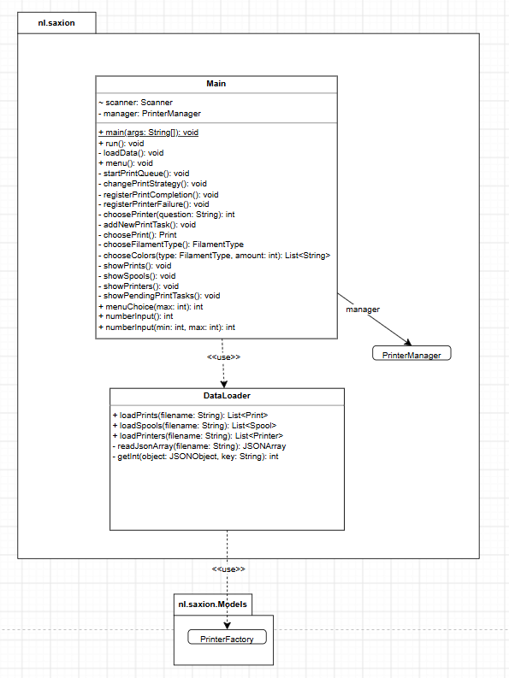
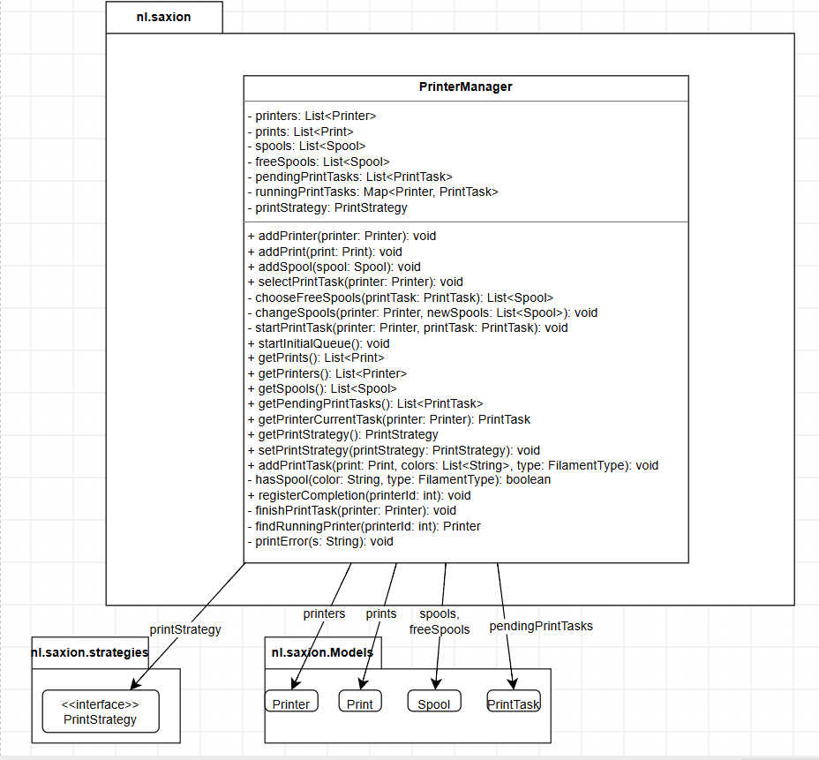
Main, DataLoader and PrinterManager
REDESIGN · LAYER 4 · §7.3
Main: console UI only. loadData() connects loader and manager; addNewPrintTask split in three.
DataLoader: 3 load methods, one readJsonArray helper; returns lists.
PrinterManager: queue and running tasks; talks only to Printer and PrintStrategy.
Check: registerPrinterFailure() is in the code, not in this diagram.
Notes:
Key sentence from 7.3: “DataLoader doesn’t know PrinterManager, and Main connects the two.” That is why the tests can create a PrinterManager without files. Main’s methods: choosePrint, chooseFilamentType and chooseColors replace the long addNewPrintTask; choosePrinter is shared by completion and failure; the strategy menu creates the strategy objects. freePrinters is gone: whether a printer is free is simply “not in runningPrintTasks”.

Slide 26
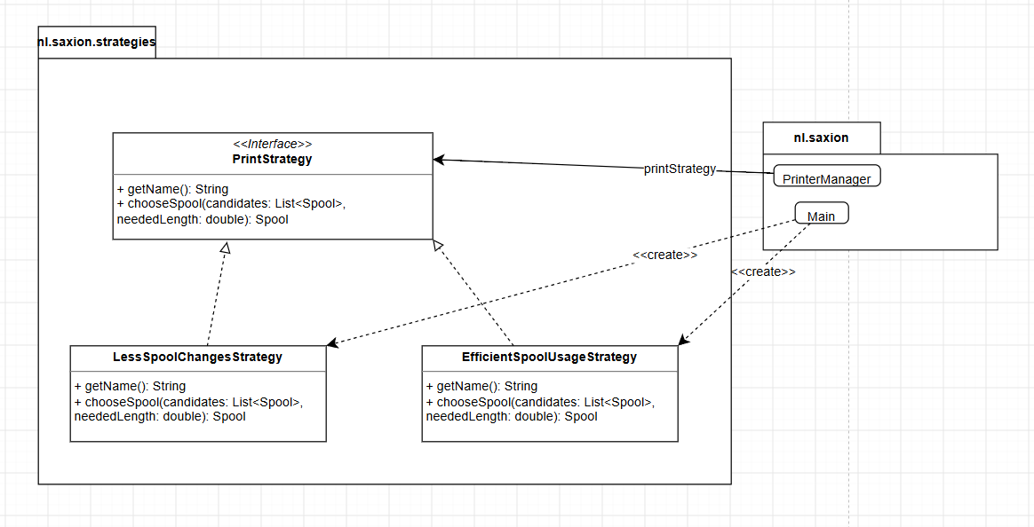
PrintStrategy: one decision, two answers
REDESIGN · STRATEGIES · §7.3
Less Spool Changes
The longest candidate: it lasts longest before the next change.
Efficient Spool Usage
The shortest candidate that still has enough filament: leftovers get used up (B6).
Spool chooseSpool(
List<Spool> candidates,
double neededLength)
// null = none usable
Called in chooseFreeSpools(), once per color, only in pass 2 when a spool change is needed. Pass 1 already keeps the loaded spool for every strategy. Default: Less Spool Changes; menu option 4 swaps it at runtime.
Notes:
Say: “For the third problem I used the Strategy pattern, with one decision only: which free spool to use. PrinterManager only knows the PrintStrategy interface.” Know the difference in behaviour: Efficient returns null when no candidate is long enough, so the task waits; Less Spool Changes always returns the longest, even if it is too short (the original did not check the length either). getName() is used by the menu to show the current strategy.

Slide 27
Why the strategy decides only the spool
REDESIGN · DECISION 1 · §10.1 · YOUR BEST PROCESS STORY
A · Rejected
B · Your first idea, rejected
C · Chosen
if/else on the strategy name
A strategy that picks the whole task
Only what really differs
Inside PrinterManager. Every new strategy changes PrinterManager again.
chooseSpool(candidates, neededLength) plus getName(). Small interface; a new strategy needs no change in PrinterManager, only a menu option.
selectTask(printer, queue, freeSpools). Written out, both strategies needed the same two passes and spool bookkeeping: duplicate code again.
Insight: a pattern only helps where the behaviour really differs. Putting the whole selection in the strategy would have copied code instead of removing it.
Notes:
This is the strongest answer to “Which alternatives did you consider?” and “How did you arrive at this design?” because it shows a first idea, a test of that idea (writing out both strategies), a reason to drop it, and a better design. Say it as a story: “My first idea was a strategy that picks the whole next task. When I wrote out both strategies, they needed the same two passes, so that code would be copied into every strategy. The only thing that really differs is which free spool is taken, so that became the one decision.”

Slide 28
Three more decisions, with alternatives
REDESIGN · DECISIONS 3 TO 5 · §10.1
3 · A simple factory
4 · No Singleton
One static method in PrinterFactory is the only place that changes when a type is added.
Considered, because there is one manager and Singleton was in the course. Main creates one manager, and that is enough.
Rejected: a switch in DataLoader (mixes reading and choosing classes); a factory class per type (too much for 3 types).
Rejected because it is global state: tests would share one manager and influence each other.
5 · PrinterManager stays one class
The running task stays in the manager
After moving the printer rules and the spool choice out, it is about one thing, with short methods.
Printer describes the machine; the queue and who runs what is the manager’s job (runningPrintTasks map).
Rejected: your first sketch, PrinterRepository + SpoolRepository + PrintQueue + Scheduler: mostly Middle Man in under 1000 lines.
Rejected: a currentTask field on Printer.
Notes:
Decision 4 links to EA1: there you also rejected the Singleton, for a different reason (several battles at once). Here the reason is testability: a Singleton manager would carry state from one test to the next. Decision 5 shows you know smells work in both directions: splitting too much creates Middle Man classes that only pass calls on.

Slide 29
SOLID: where each principle lives
REDESIGN · SOLID · §7.4
S
Single responsibility
Main = console UI, DataLoader = files, PrinterManager = queue and assigning, printers = what they can print, strategies = which spool.
A new file format only touches DataLoader.
O
Open/Closed
New printer type: subclass + one factory line. New strategy: class + one menu option. New filament: one enum value.
PrinterManager changes for none of these.
L
Liskov substitution
PrinterManager only uses Printer. HousedPrinter only allows more filament, MultiColor more colors.
Every subclass works everywhere.
I
Interface segregation
PrintStrategy has only the two methods the manager and the menu need.
No strategy implements what it doesn’t use.
D
Dependency inversion
PrinterManager depends on the PrintStrategy interface, not on the concrete strategies; Main chooses which one is used.
Strategies swap at runtime.
Notes:
Two honest footnotes, in case they dig. Open/Closed: a new strategy still needs a menu option in Main, but PrinterManager stays closed. Dependency inversion: PrinterManager does create its default strategy itself (new LessSpoolChangesStrategy() as the field’s initial value), so it imports one concrete class. Cleaner would be Main passing the strategy in through the constructor. Say that before they find it.

Slide 30
Three patterns, and one you rejected
REDESIGN · PATTERNS · §7.4
Pattern | Where | Why | Precisely
Strategy | PrintStrategy, LessSpoolChanges, EfficientSpoolUsage | Jack switches spool choice while running; new strategies later | Interchangeable algorithms behind one interface, chosen at runtime
Simple Factory | PrinterFactory.createPrinter() | One place turns the type number into a class | An idiom, not a GoF pattern; Factory Method would need creator subclasses
Template Method | Printer.canPrint(); toString() with details() | Steps fixed in Printer; subclasses fill in their part | canPrint calls abstract steps; details() is a hook with a default
Singleton | Considered for PrinterManager | There is only one manager | REJECTED: global state, tests would share it
Notes:
Template Method in one sentence: the base class fixes the order of the steps, and subclasses only fill in steps. canPrint() is the classic form (it calls three abstract operations: printFits, supportsFilament, getMaxColors); toString() is the hook form (details() returns "" by default and StandardFDM and MultiColor add lines). It replaces two smells: the instanceof checks and the string replace/split in the old toString(). If they ask “why not Factory Method?”: Factory Method lets subclasses of a creator decide which object to make; here one static method with three cases is enough, and you rejected a factory class per type as too much for three types.

Slide 31
What changed, file by file
REFACTORING · §8
File | Change
Main | Only the console UI: loading moved out, addNewPrintTask split in three, shared choosePrinter, the strategy menu creates real strategies
DataLoader (new) | Reads the 3 JSON files with one helper, returns lists, uses getResourceAsStream
PrinterManager | Short selectPrintTask with helpers, no instanceof, shared finishPrintTask, add methods take objects, dead code removed
strategies (new package) | PrintStrategy and two implementations
Printer | Spools as a list, canPrint, hasSpoolsFor, details() hook; CalculatePrintTime removed
StandardFDM, HousedPrinter, MultiColor | Only override what is different
PrinterFactory (new) | Type number to printer class
Spool, Print, PrintTask | reduceLength fixed, spoolMatch shorter; List instead of ArrayList; getLength() returns int
Notes:
Line counts after the refactoring: PrinterManager 197 (was 304), Main 234 (was 385), DataLoader 72, Printer 84, StandardFDM 36, HousedPrinter 14, MultiColor 21 (was 59), PrinterFactory 16, the strategies 13 + 24 + 24. Total roughly the same size, but spread over classes that each have one job. That is a good answer to “did the refactoring make the code bigger?”.

Slide 32
selectPrintTask: 110 lines became 23
CODE · PRINTERMANAGER.JAVA LINE 31
Before → after
public void selectPrintTask(Printer printer) {
110 → 23 lines
if (runningPrintTasks.containsKey(printer)) {
return;
6 → 3 levels of nesting
}
6 → 0 instanceof checks
for (PrintTask printTask : pendingPrintTasks) { // pass 1
if (printer.canPrint(printTask) && printer.hasSpoolsFor(printTask)) {
6 → 1 start-task block
startPrintTask(printer, printTask);
Busy check: missing → the first line (the bug you found by splitting)
return;
}
}
Each return comes right after the task is removed, so no ConcurrentModificationException.
for (PrintTask printTask : pendingPrintTasks) { // pass 2
if (printer.canPrint(printTask)) {
List<Spool> chosenSpools = chooseFreeSpools(printTask);
if (chosenSpools != null) {
changeSpools(printer, chosenSpools);
startPrintTask(printer, printTask);
return;
}
}
}
}
Notes:
The comments “pass 1” and “pass 2” are shortened here; in your file they read “First we look if there’s a task that matches the current spools on the printer” and “If we didn’t find a print for the current spools we search for a print with the free spools”. Indentation is 2 spaces here to fit the slide. Say: “Pass one keeps the loaded spools, pass two changes spools through the strategy. There is no instanceof any more. Splitting the method also showed a bug: a busy printer could lose its task. That check is now the first if.” The nesting count after (3) is my count of the deepest block in this method, not a number from your PDF.

Slide 33
canPrint(): the template method
CODE · MODELS/PRINTER.JAVA LINES 40 AND 47 · SUBCLASSES
// Printer (abstract)
// StandardFDM
public boolean canPrint(PrintTask task) {
public boolean printFits(Print print) {
return printFits(task.getPrint())
return print.getHeight() <= maxZ
&& supportsFilament(task.getFilamentType())
&& print.getWidth() <= maxX
&& task.getColors().size() <= getMaxColors();
&& print.getLength() <= maxY;
}
}
public boolean hasSpoolsFor(PrintTask task) {
supportsFilament(type): type != ABS
List<String> colors = task.getColors();
getMaxColors(): 1
if (currentSpools.size() < colors.size()) {
return false;
// HousedPrinter extends StandardFDM
}
supportsFilament(type): true
for (int i = 0; i < colors.size(); i++) {
if (!currentSpools.get(i).spoolMatch(
// MultiColor extends StandardFDM
colors.get(i), task.getFilamentType())) {
getMaxColors(): maxColors
return false;
}
// shorthand, not literal code
}
return true;
}
Notes:
The left card is your real code (2-space indents). The right card shows printFits in full and the other overrides in shorthand. Say: “canPrint in Printer: the steps are fixed and the subclasses fill in their part.” The orange lines in hasSpoolsFor are the fix for the old crash: compare the counts first, so a printer with fewer loaded spools than the task has colors never reads a missing spool. Notice MultiColor inherits supportsFilament from StandardFDM, so it cannot print ABS, exactly as in the original.

Slide 34
Spool bookkeeping in one place
CODE · PRINTERMANAGER.JAVA LINES 75 AND 172
addAll of a list: empty at first, so no null spool goes into freeSpools (bug 1).
private void changeSpools(Printer printer,
List<Spool> newSpools) {
freeSpools.addAll(printer.getCurrentSpools());
All old spools go back first, then the printer gets only the new list: no spool in two printers (bug 4).
freeSpools.removeAll(newSpools);
printer.setCurrentSpools(newSpools);
One finishPrintTask for completion and failure (was duplicated). A failed print also used filament.
// + a “Spool change” message per spool
}
Failure = re-queue the task, finishPrintTask, selectPrintTask (line 162).
private void finishPrintTask(Printer printer) {
PrintTask task = runningPrintTasks.get(printer);
runningPrintTasks.remove(printer);
// + “Task … removed from printer …”
List<Spool> currentSpools = printer.getCurrentSpools();
for (int i = 0; i < currentSpools.size()
&& i < task.getColors().size(); i++) {
currentSpools.get(i).reduceLength(
task.getPrint().getFilamentLength().get(i));
}
}
Notes:
registerCompletion (line 154) and registerPrinterFailure (line 162) now differ by exactly one line: the failure version first adds the running task back to the pending list. Both then call finishPrintTask and selectPrintTask. The failed task goes to the end of the queue, the same as in the original code. In the test failedTaskGoesBackToTheQueueAndStillUsesFilament, it is the only task, so the printer starts it again with the same spool.

Slide 35
The Strategy, end to end
CODE · STRATEGIES/ · MAIN.JAVA LINE 80 · PRINTERMANAGER.JAVA LINE 56
public interface PrintStrategy {
// Main.changePrintStrategy()
String getName();
if (strategyChoice == 1) {
// null when no candidate can be used
manager.setPrintStrategy(
Spool chooseSpool(List<Spool> candidates,
new LessSpoolChangesStrategy());
double neededLength);
} else {
}
manager.setPrintStrategy(
new EfficientSpoolUsageStrategy());
// LessSpoolChanges: the longest
}
if (chosen == null
|| spool.getLength() > chosen.getLength())
// PrinterManager.chooseFreeSpools()
chosen = spool;
// once per color of the task:
Spool chosenSpool = printStrategy
// EfficientSpoolUsage: shortest that fits
.chooseSpool(candidates, length(i));
if (spool.getLength() >= neededLength
if (chosenSpool == null) {
&& (chosen == null
return null;
|| spool.getLength() < chosen.getLength()))
}
chosen = spool;
Notes:
Walk it left to right in the demo: the interface (one decision), the two answers, the menu that creates the objects, and the single place the manager calls it. “length(i)” is shorthand for printTask.getPrint().getFilamentLength().get(i). Candidates are the free spools that match the color and filament type and are not already chosen for another color of the same task. If any color gets null, chooseFreeSpools returns null and the task is skipped for this printer.

Slide 36
Loading the data, building the printers
CODE · DATALOADER.JAVA LINE 55 · MODELS/PRINTERFACTORY.JAVA · MAIN.JAVA LINE 46
private JSONArray readJsonArray(String file) {
// PrinterFactory (condensed)
InputStream stream = getClass()
static Printer createPrinter(int type, ...)
.getResourceAsStream("/" + file);
type 1 → new StandardFDM(...)
if (stream == null) {
type 2 → new HousedPrinter(...)
System.err.println("Warning: ...");
type 3 → new MultiColor(..., maxColors)
return new JSONArray();
else → throw new
}
IllegalArgumentException(...)
try (Reader reader = new InputStreamReader(
stream, StandardCharsets.UTF_8)) {
// Main.loadData(): Main connects
return (JSONArray) new JSONParser()
// the loader and the manager
.parse(reader);
for (Printer printer :
} catch (IOException | ParseException e) {
loader.loadPrinters("printers.json")) {
e.printStackTrace();
manager.addPrinter(printer);
return new JSONArray();
}
}
}
Notes:
The left card is real code (the parameter is called filename in your file). It replaces three copies of getResource → file path → URLDecoder → FileReader. The try-with-resources closes the reader; a missing file gives a warning and an empty list instead of a crash. The right card condenses PrinterFactory’s if/else-if chain: in the file it is a normal if (type == 1) … else if (type == 2) … chain. That is fine there: one switch on the type number in ONE place is the point of a factory; the smell was the same decision spread over PrinterManager.

Slide 37
If they say “show us the code”
LIVE DEMO SCRIPT · PATHS UNDER SRC/MAIN/JAVA/NL/SAXION
# | Open | Say
1 | PrinterManager.java : 31 | “selectPrintTask: 110 lines became 23. Busy check first, then two passes, no instanceof.”
2 | Models/Printer.java : 40, 47 | “canPrint is the template method; hasSpoolsFor is pass 1.” Then open StandardFDM, HousedPrinter, MultiColor.
3 | strategies/PrintStrategy.java | “One decision: which free spool.” Then both strategies, then Main.java : 80 creating them.
4 | PrinterManager.java : 56, 75 | “chooseFreeSpools calls the strategy; changeSpools fixed the null spool and the spool in two printers.”
5 | Models/PrinterFactory.java, DataLoader.java : 55 | “The only place with type numbers; one helper reads all three files.”
6 | tests/nl/saxion/PrinterManagerTest.java | Run all 9 tests: green. “No Main and no JSON needed, except the truth table.”
Notes:
Step 7, if they want to see it run: start Main, then menu 1 (add Octopus, PLA, a color), 5 (start queue), 7 (show printers: the task and the spool), 4 (the strategy menu now shows the current strategy’s name). Practise this once tonight with IntelliJ open, using Ctrl+N (or Cmd+O on a Mac) to open a class by name and Ctrl+G to jump to a line. If they ask for something specific, jump straight there instead of following the order. Line numbers are from the version in your submission folder (Downloads/RokasPazera551495/…/exam2/3dprintscheduler-main). If your IntelliJ project is a different copy, check the line numbers once.

Slide 38
Nine tests, all green
TESTING · §9 · TESTS/NL/SAXION/PRINTERMANAGERTEST.JAVA
Test (first six from testing.md) | What it proves
taskGoesToPrinterThatAlreadyHasTheMatchingSpool | Same spool kept, no spool change
spoolChangeIsInitiatedWhenThePrinterHasNoMatchingSpool | The red spool is placed for a red task
taskStaysInQueueWhenNoPrinterCanPrintIt | Moon Lamp (258 mm) stays in the queue
readyPrinterSelectsTaskThatFitsAndUsesTheSameSpool | Skips a too-big task and an other-color task
startingTheQueueFillsAllPrinters | 3 printers get 3 tasks, ABS on Bebop
blueRedBlueSelectsTheThirdTaskWhenThePrinterIsReady | The third (blue) task wins over red
failedTaskGoesBackToTheQueueAndStillUsesFilament | Restarted; spool reduced by 2.86
strategiesChooseTheRightSpool | Longest (100) vs shortest that fits (5, not 1)
printersMatchTheTruthTable | canPrint for 9 prints × 7 printers, PLA and ABS
State, not text: each test builds a small situation and checks which task runs where and which spool is loaded.
Serenity: testing.md says it prints ABS; printers.json says type 1. The test follows the data.
Notes:
Why this was impossible before: PrinterManager was only reachable through Main and the JSON files, and printers could only be made through addPrinter with a type number. Now a test does new PrinterManager(), new StandardFDM(...), addSpool(...), addPrintTask(...), then checks getPrinterCurrentTask(). The tests are JUnit 4 (@Before, @Test) in the tests folder, which your .iml marks as the test source root. Tonight: right-click the tests folder in IntelliJ, Run ‘All Tests’, and check all 9 are green. Also know the truth-table difference: in testing.md Serenity can print ABS, but printers.json gives Serenity type 1 (StandardFDM, no ABS). You kept the data unchanged and made the test follow it; the same goes for the row order, which follows prints.json.

Slide 39
How you arrived at this design
PROCESS · §10 · “HOW DID YOU ARRIVE AT THIS DESIGN?”
1
Analyse: class diagrams with the hidden instanceof links; how selectPrintTask works.
Your three insights (§10.2)
2
Name the smells with their refactoring.guru names, each with “why it hurts”.
A pattern only helps where the behaviour really differs.
3
Find the causes: five structural problems; bugs found while reading.
4
Redesign layer 3 (five components), then layer 4 (printers, strategies, manager, loader, UI).
Testability is a good check of a design.
5
Test ideas before coding: wrote out both strategies (dropped the whole-task idea), sketched a 4-class split (dropped: Middle Man), weighed Singleton and a flags-only Printer.
Small methods make bugs visible.
6
Refactor along the design; splitting selectPrintTask exposed two more bugs.
7
Validate: the testing.md tests plus three more.
Notes:
This order follows the structure of your TD2 and the decisions it describes; the exact days are not in the document, so tell it as an order, not as dates. The three insights are also the takeaways of your presentation’s last slide (“design from the interface outward, use a pattern only where the behaviour differs, use testability as a check”), so they connect both assignments.

Slide 40
Trade-offs: say them before they do
PROCESS · TRADE-OFFS AND KNOWN LIMITS
Manager still prints
Subclasses, not flags
Behaviour changed
Kept on purpose: same console text for Jack. Tests check state, not text.
A housed multi-color printer needs one new class and one factory line.
8 bug fixes and the spool choice, all documented in §6.2.
Default strategy inside
No length check
IDE-bound tests
PrinterManager does new LessSpoolChangesStrategy() itself: one concrete import.
Less Spool Changes may pick a spool that is too short (as before); reduceLength’s result is ignored.
JUnit 4 via the IntelliJ module file; no build tool such as Maven.
Notes:
The top row are choices you made and documented. The bottom row are limits I found in the code that are not in your PDF; name them yourself if the conversation goes there, with the fix: pass the strategy in through the constructor; skip candidates shorter than neededLength (or warn Jack); add a small Maven or Gradle build so the tests run anywhere. A spool length going below 0 does show up in “Show spools”, which at least tells Jack which spools to order (B4).

Slide 41
Defence drill
PART 7
For EA2 every answer can end in the code. Use the same four beats as in EA1, with one extra:
Smell or problem
→
Decision
→
Rejected alternative
→
The lines of code
Notes:
Example. Q: “Why did you use the Strategy pattern?” Problem: the strategy menu only changed a String, so nothing behaved differently, and Jack wants a way to use up leftover spools (B6). Decision: a PrintStrategy interface with one decision, chooseSpool, and two implementations that Main creates. Rejected: a strategy that picks the whole task, which needed the same two passes in every strategy. Code: open PrintStrategy.java, then chooseFreeSpools in PrinterManager line 56.

Slide 42
“It must behave the same”, and the code
DEFENCE DRILL · WEAK SPOTS (1 OF 2)
Q: “The assignment says the code must still behave the same. Why did you change behaviour?”
“For every normal case it does: the same menu, the same messages and the same two-pass selection. I only changed behaviour where the old code crashed, lost a task, or did nothing, and I listed every change in 6.2. The strategy menu now works, because choosing a strategy is a requirement (F9) that the old code only faked.”
They may notice | Your answer
PrinterManager creates its default strategy itself | “A small DIP leak to keep the old default. Cleaner: Main passes it in through the constructor.”
Less Spool Changes ignores neededLength | “Like the original. Efficient does check. The fix: skip candidates that are too short.”
PrinterManager still uses System.out | “Kept on purpose and listed as a smell: same console text; the tests check state.”
Notes:
The first answer is the most important one of EA2; learn it word for word. The rows are things an examiner might spot while you have the code open. The first two are not in your PDF, so they would be new to the examiner too; naming the fix immediately shows you understand the design rather than defending it blindly.

Slide 43
Slips in the document, and what to say
DEFENCE DRILL · WEAK SPOTS (2 OF 2)
Where | What they may notice | Your answer
§2.2 | Use case lines have arrowheads | “In UML the actor-to-use-case association is a plain line.”
§2.1, 3.1, 7.1 | C4 labels “[]”, “[java 21]”, “[: JSON]”; no legend | “Each element should show its type and technology, with a legend, as in my EA1 diagrams.”
§3.2 | “json-siimple.jar”; JSON files outside the Java box | “A typo. The files are read from the classpath, so they belong with the classes.”
§7.3 | registerPrinterFailure() missing in the PrinterManager diagram | “It is in the code, line 162; the diagram misses it.”
§9 | Truth-table test differs from testing.md (Serenity, ABS) | “printers.json says Serenity is type 1, so I followed the data.”
Contents | Page numbers show “9” for most sections | Navigate by section number (slide 5).
Notes:
Same tone as in EA1: “Good catch, that should be X.” Then move on. None of these touch the design itself. If they push on notation in general, point out that your EA2 use case diagram uses ovals, a boundary and a correct dashed «include», and that the C4 layers line up: the five layer-3 components map one-to-one to the classes and packages in the table of 7.1.

Slide 44
The code analysis
DEFENCE DRILL · LIKELY QUESTIONS (1 OF 3)
How did you find the smells?
Smell or structural problem?
Read every class, drew the old diagrams with the hidden instanceof links, named each smell with its refactoring.guru name, and gave each one a fix.
A smell is a local sign (a long method); a structural problem is how the program is organised. Four smells come from “types not used as types”.
What was the worst problem?
Why was HousedPrinter a Lazy Class?
selectPrintTask: 110 lines, 6 levels, every printer rule in instanceof branches. A new printer type touched 6 places.
It was empty; its ABS rule lived in PrinterManager. Now it owns the rule: supportsFilament returns true.
Why is instanceof a smell?
How do you know the bugs were real?
The caller decides what a type can do, so every new type edits the caller. Polymorphism moves the rule into the class itself.
The null spool crashes once the queue starts with tasks for two printers; the busy and null checks showed up after splitting the method.
Notes:
The four smells from “types not used as types” are Switch Statements (instanceof), Feature Envy (PrinterManager deciding for the printer), Refused Bequest (MultiColor) and Lazy Class (HousedPrinter). Being able to group smells under a cause is what makes an analysis “well-founded” in the rubric’s words.

Slide 45
The redesign
DEFENCE DRILL · LIKELY QUESTIONS (2 OF 3)
Why does the strategy only pick the spool?
Why no Singleton?
A whole-task strategy needed the same two passes in every strategy. The only real difference is which free spool is taken.
Global state: the tests would share one manager. Main creates one; nothing needs global access.
Why not one Printer class with flags?
Why not split PrinterManager further?
The data already uses type numbers and the rules differ per type. A housed multi-color printer is one subclass plus one factory line.
In under 1000 lines most new classes would only pass calls on (Middle Man). With the rules moved out, it is about one thing.
Why a static factory, not Factory Method?
Where exactly is Template Method?
Three types, one place to change. Factory Method needs creator subclasses; a factory per type was too much.
canPrint() calls printFits, supportsFilament and getMaxColors; toString() calls the details() hook.
Notes:
All six answers are your own decisions from section 10.1, compressed. For each one, the rejected alternative is the strongest part; say it. If they ask about Liskov: PrinterManager only uses Printer, and every subclass can stand in for it: HousedPrinter only allows more filaments, MultiColor more colors, and none of them throws or changes what canPrint means.

Slide 46
Code, tests and what-ifs
DEFENCE DRILL · LIKELY QUESTIONS (3 OF 3)
Where would a new printer type go?
How do the tests run without the files?
A new subclass that overrides what differs, plus one line in PrinterFactory. PrinterManager does not change.
PrinterManager receives objects, so each test builds its own printers and spools. Only the truth table loads the JSON.
And a third strategy?
What happens when a print fails?
A class that implements PrintStrategy, plus one menu option in Main. PrinterManager does not change.
The task goes back to the end of the queue, the filament is still reduced, then the printer gets a task: as in the original.
And a new filament, like TPU?
What would you do next?
One enum value; the menu lists it automatically. A printer rule goes in supportsFilament if needed.
Strategy through the constructor, output through a listener, a length check in Less Spool Changes, a Maven build.
Notes:
For the three what-ifs, offer to show it: “Shall I open PrinterFactory?” That turns a question into a demo, which is what the refactoring row of the rubric rewards (“convincingly demonstrated”). If they ask what “Open/Closed” means here, the first two answers are the proof: new behaviour by adding classes, not by editing PrinterManager.

Slide 47
Numbers to have ready
CHEAT SHEET
385
304
23
6
6
lines in the old Main
lines in the old PrinterManager
lines in selectPrintTask (was 110)
places a new printer type touched
copies of the start-task block
14
5
8
2 → 5
3
rows in the smells table
structural problems
bugs fixed (§6.2)
layer-3 components
patterns, Singleton rejected
9
2
3
7
9
unit tests, all passing
strategies, 1 decision
printer types (1, 2, 3)
printers in printers.json
prints in prints.json
Notes:
The five components: Console UI, Data Loader, Printer Manager, Print Strategies, Domain Model. The three patterns: Strategy, Simple Factory, Template Method. The five structural problems: no separation; types not used as types; no extension point for scheduling; state in several places; loading takes too many steps. The 7 printers: Enterprise, Serenity, Red Dwarf, Tardis (standard), Rocinante, Bebop (housed), Heart of Gold (multi-color, 4 colors).

Slide 48

Tonight and tomorrow morning
LAST SLIDE
Tonight, in IntelliJ: open 3dprintscheduler-main, run all 9 tests (JUnit 4 must resolve) and run Main once.
Tomorrow morning, 10 minutes
Walk the demo once (slide 37), opening classes by name and jumping to line numbers.
Slide 3 · the story
Slide 4 · four problems, four fixes
Your EA2 part of the presentation: slides 8 to 12, about 2:40 (case 10 s, analysis 45 s, redesign 40 s and 30 s, code 35 s).
Slide 27 · why only the spool
Slide 32 · selectPrintTask
Learn word for word: the “behaves the same” answer (slide 42).
Slide 42 · “behaves the same”
Slide 47 · numbers
Drill out loud: weak spots (42, 43) and the 18 questions (44 to 46).
Don’t know? Say where in the code it would live, and open that file.
You found real bugs, fixed the real problems, and can show every change. Open the file, point at the line, say why.
Notes:
Together with the EA1 deck this covers the whole assessment. If the presentation runs long, your talking script already lists safe cuts (slide 10’s last sentence, slide 11’s Singleton sentence); keep those as answers for the questions instead.

